Slide 1
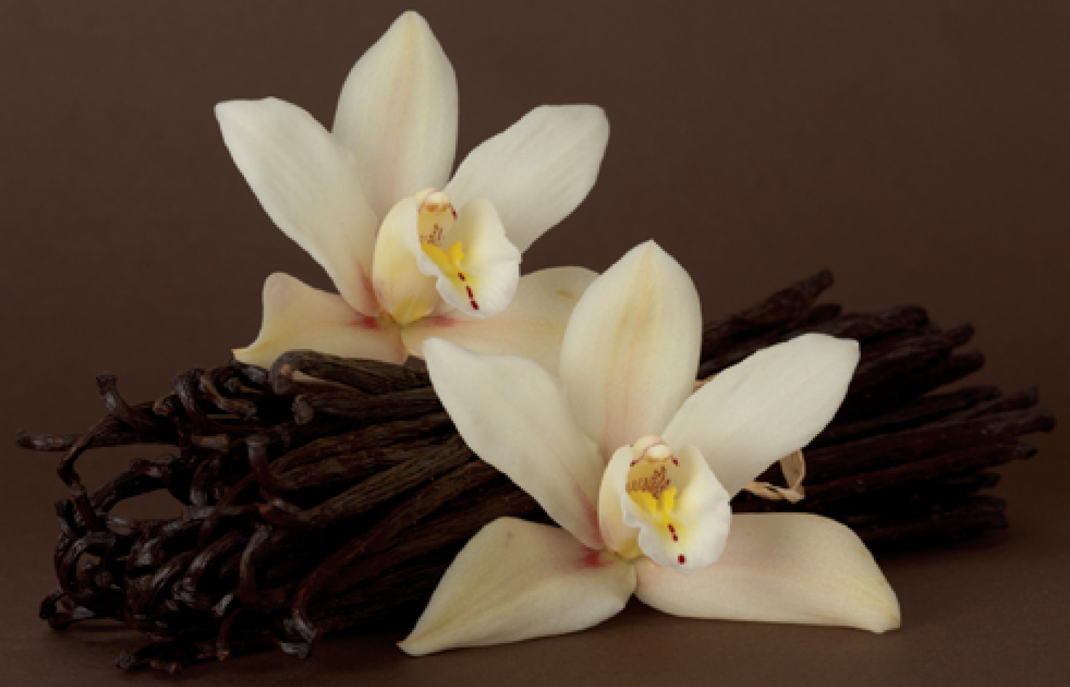
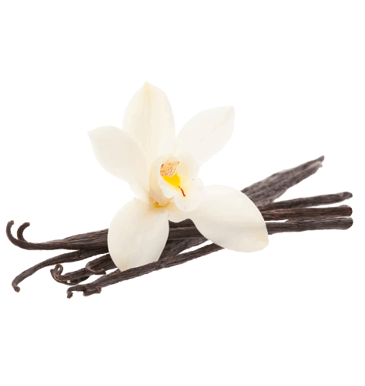
Vanilla
Production, Price and Insights
By Team Data Whiz

Slide 2
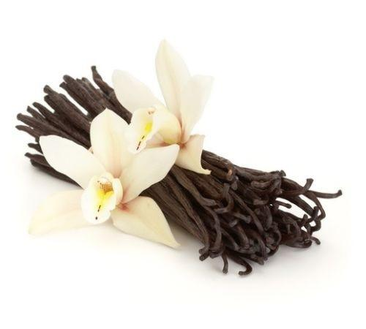
Contents
Introduction
Assumptions
Why is vanilla expensive?
Geographic distribution of producers
Leading Vanilla Producers
Area Harvested and Production
Global Production Trend
Countries and their yield
Price trend analysis
Effect of climate on price
Price and production
Minimum and maximum price

Slide 3

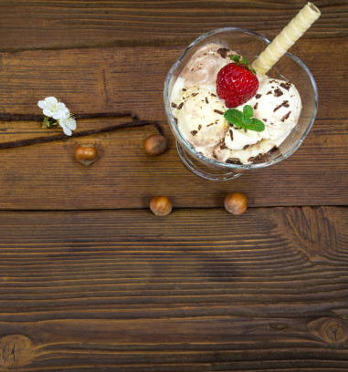
Introduction
The word vanilla is derived from a Spanish origin word “vainilla” meaning “little pod”.
Native to Mexico.
Most preferred ice-cream flavor is vanilla
Vanilla is mainly used in food, cosmetic and medicinal industries.
Less than 1% of global market in vanilla flavor is sourced from natural beans.
Notes:
International Ice Cream Association puts Vanilla ice cream as the first choice of 29 percent of ice-cream eaters, followed by chocolate (8.9 percent), butter pecan (5.3 percent), and strawberry (5.3 percent).\
Vanilla is a stunningly complex and subtle spice, containing at a guess somewhere between 250 and 500 different flavor and fragrance components.

Slide 4

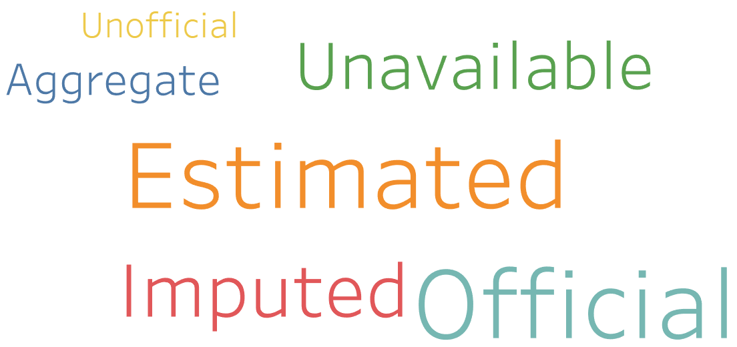
Assumptions
The analysis, visualization and insights are derived based on given data. Data preprocessing is not done
Data was not segregated based on the flags for each row
0 value in the record corresponds either to no production/ yield/harvest.
Notes:
We analysed the flags using frequency and the results are as shown in the word cloud. Since there was no huge variation in the segregation, we decided to proceed without classifying the data into estimated, unavailable, official or imputed.

Slide 5
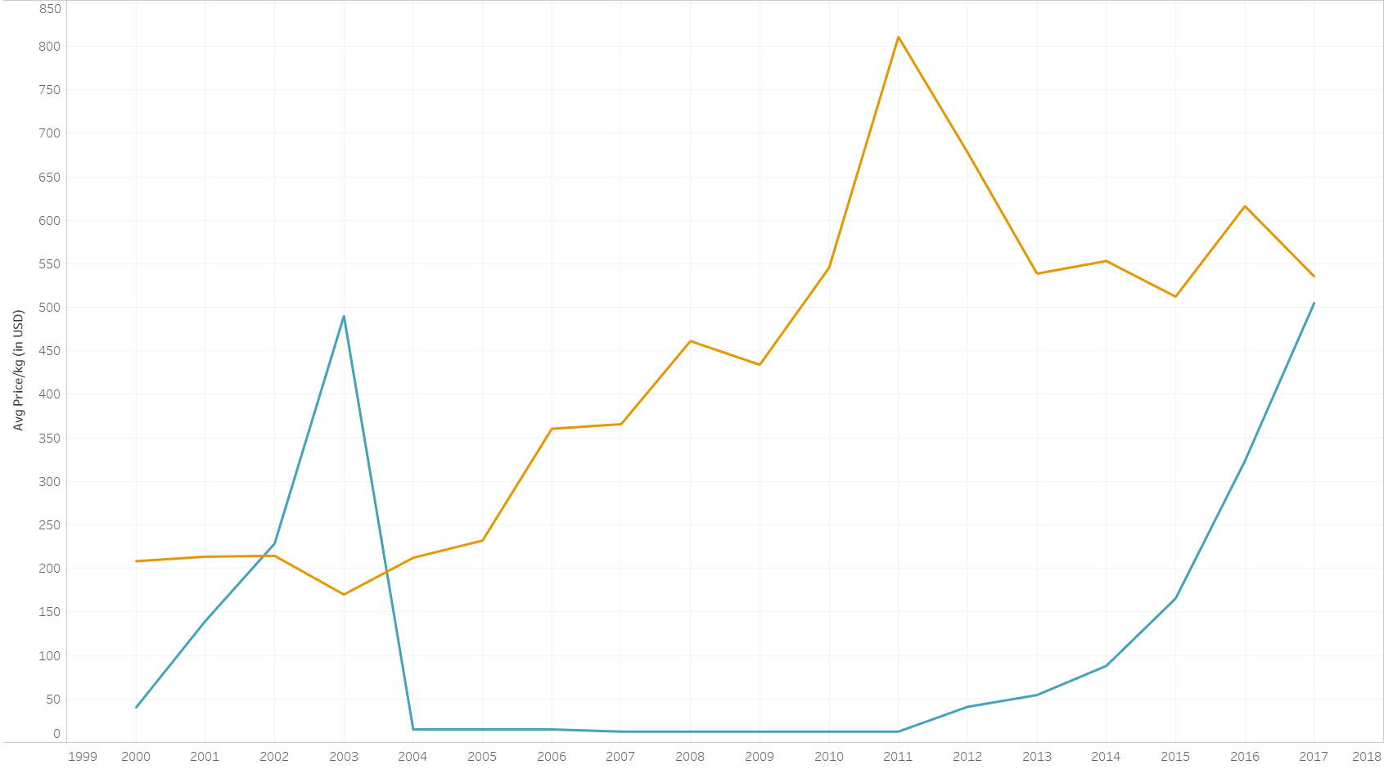

Why is Vanilla Expensive?
One of the most expensive spices in the world, second to Saffron.
Labour intensive
It takes three to four years for a new plant to produce vanilla pods
The whole process of production from pollination to curing and drying takes about a year
Notes:
The graph shows the avg price of vanilla and that of silver across year.
These-in Mexico, vanilla’s native habitat-are pollinated by melipona bees and, occasionally, by hummingbirds.
Each flower remains open for just 24 hours, after which, if not pollinated, it wilts, dies, and drops to the ground.

Slide 6
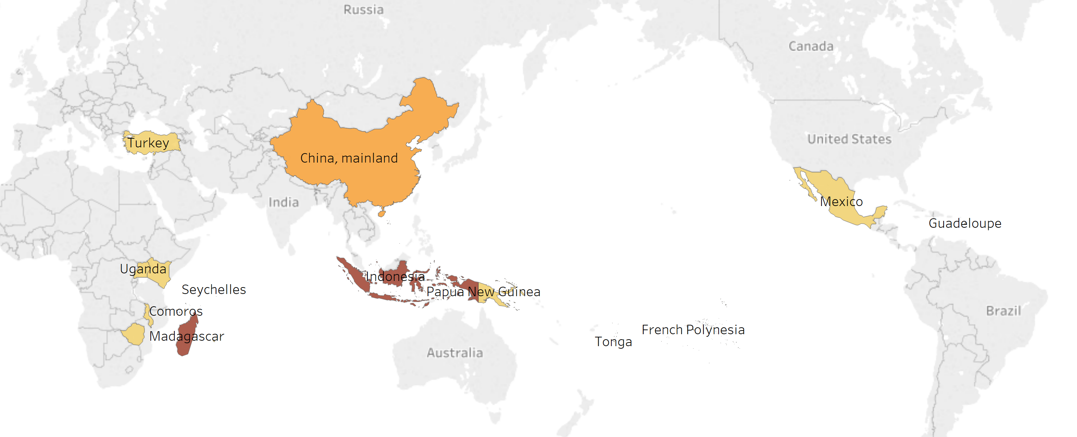
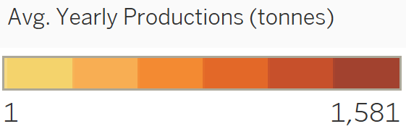
Geographic distribution of producers
Vanilla is mainly produced in the tropics
Notes:
Vanilla is a native of South and Central America and the Caribbean
Vanilla prefers a hot, moist climate with frequent rain and an average temperature of 27 degrees Celsius

Slide 7
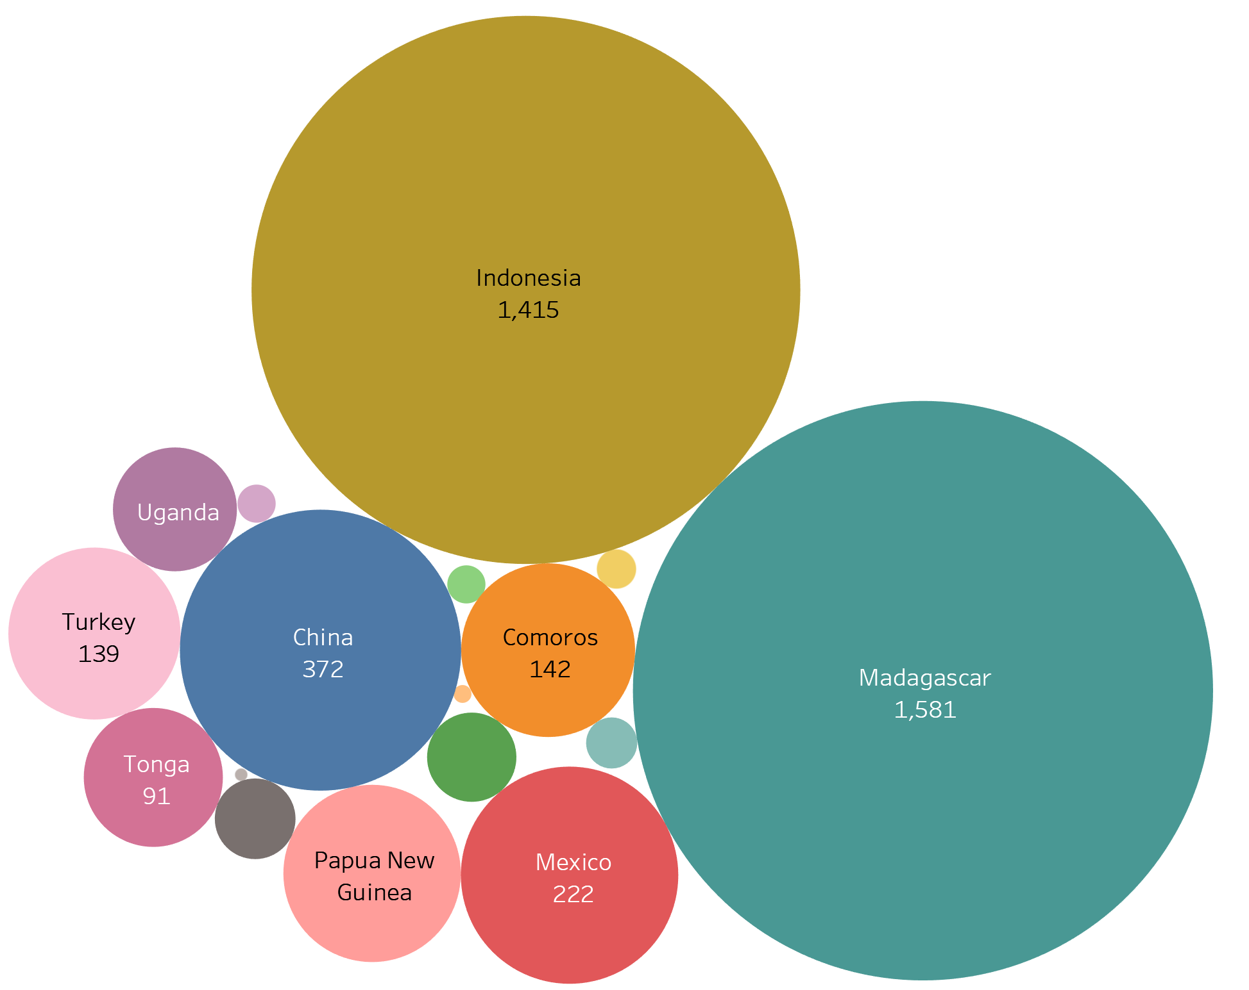
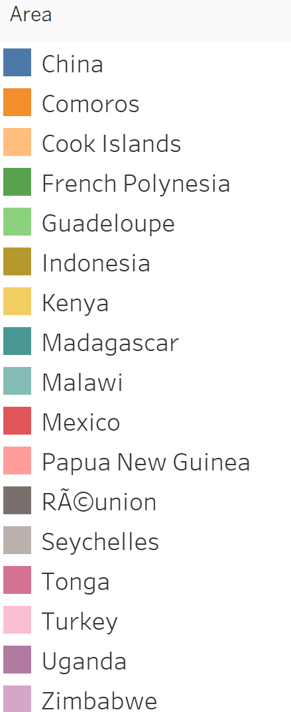
Leading Vanilla Producers
The leading producer of Vanilla is Madagascar , producing around an average of 1581 tons every year
Notes:
Labor intensive- so countries with cheap labor

Slide 8
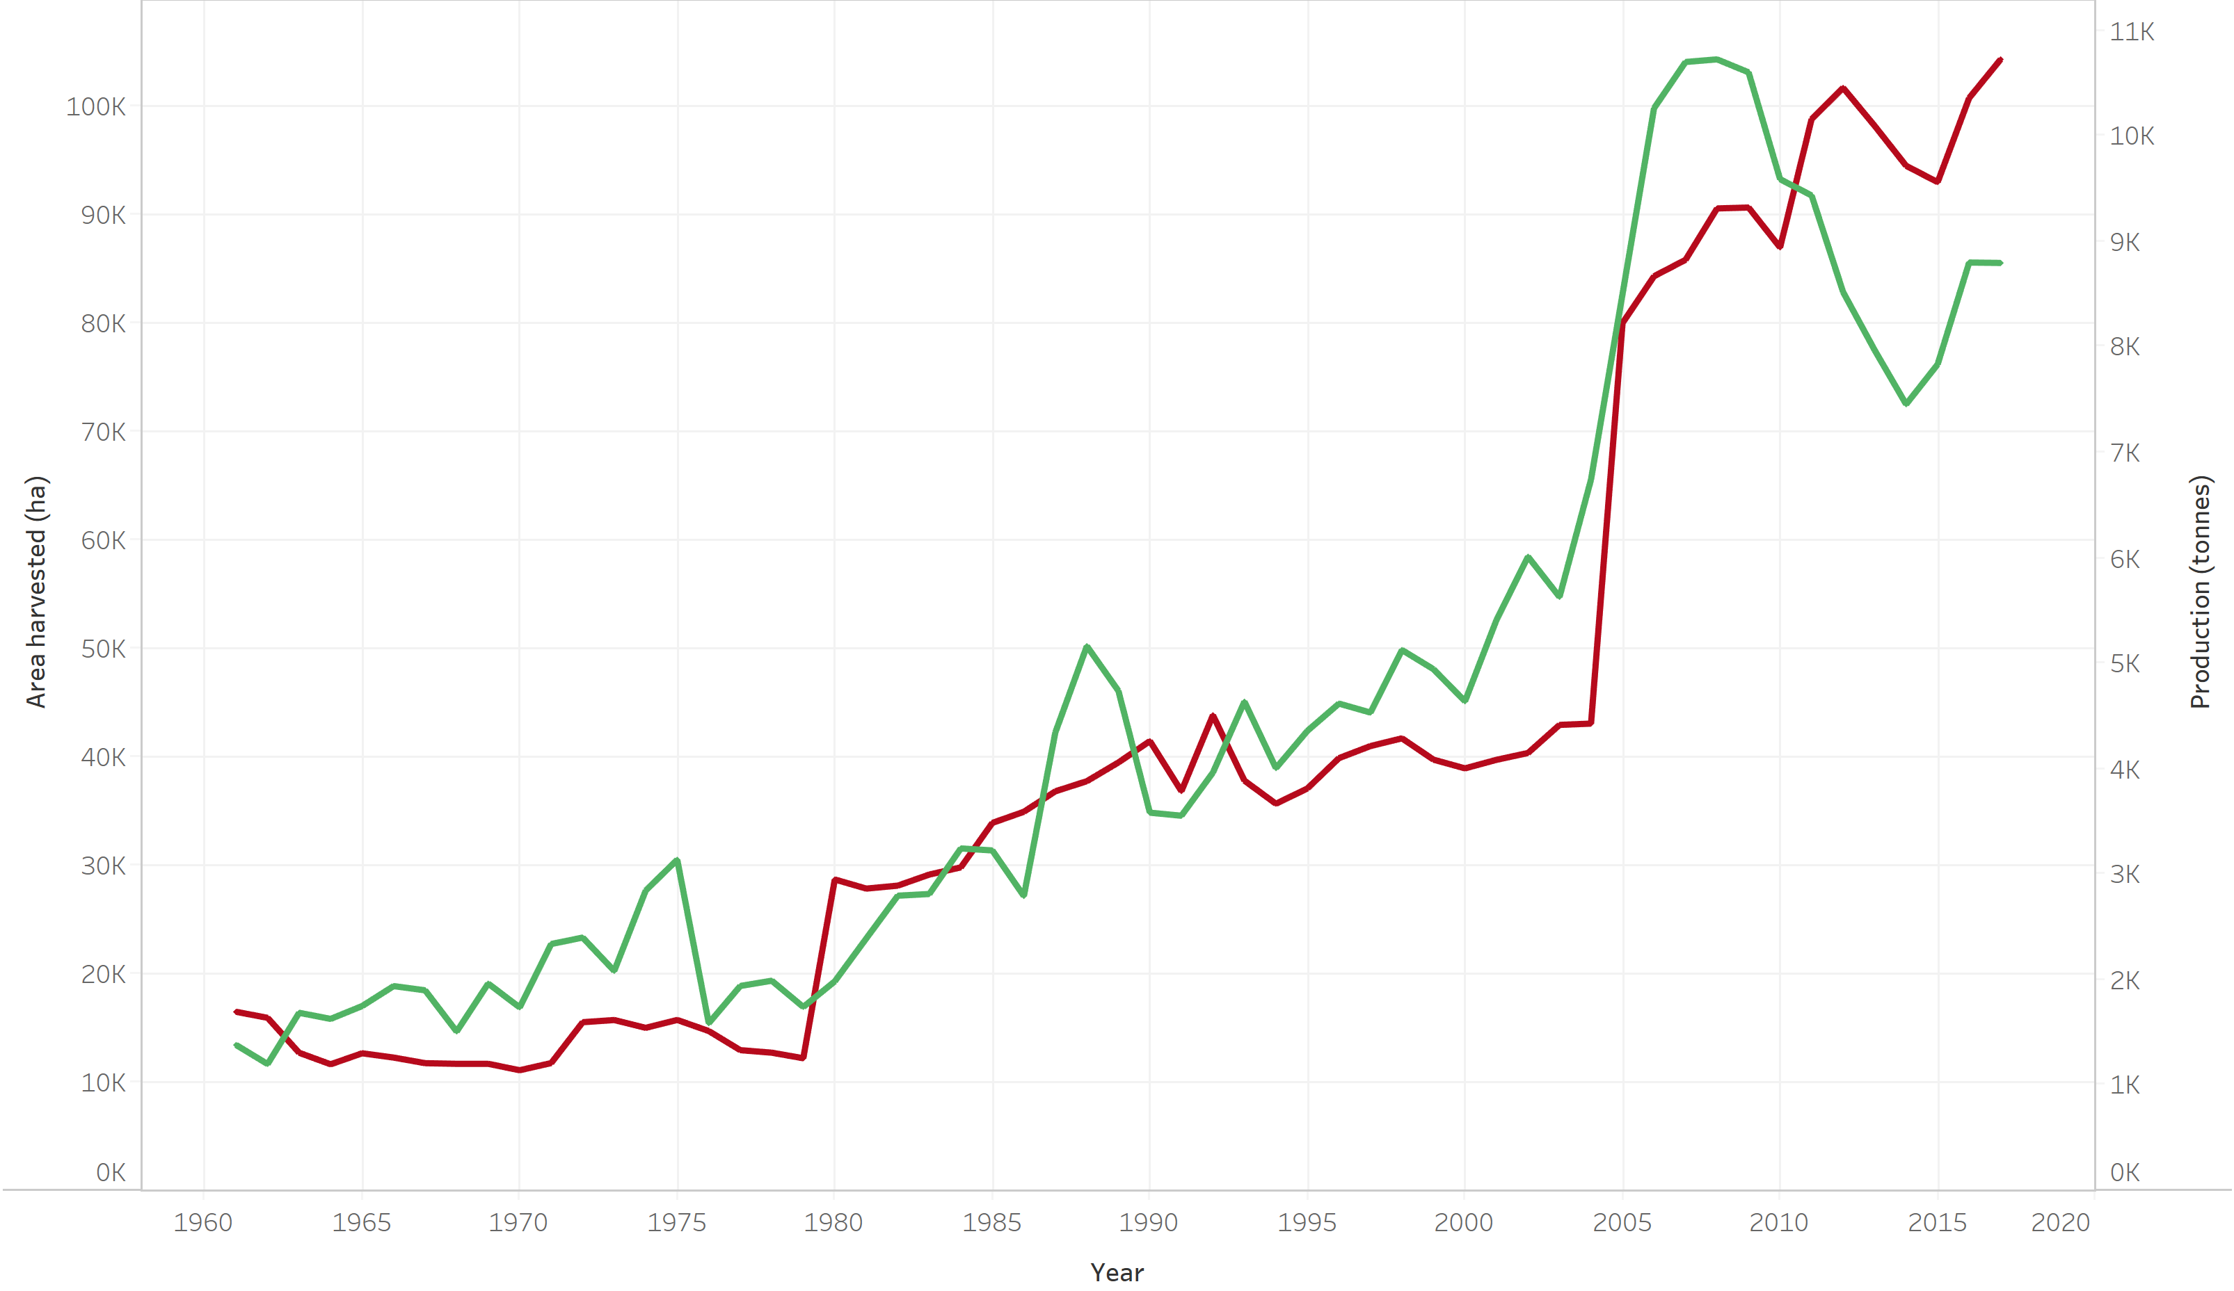
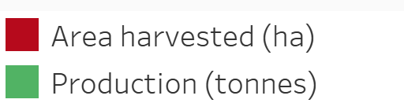
Area Harvested and Production
Till 1980, the global production was limited to a few countries.
The globalization increased the demand and hence the shoot in production and yield from the 80’s
The exponential increase in price led to increase in cultivation of vanilla during the year 2000

Slide 9
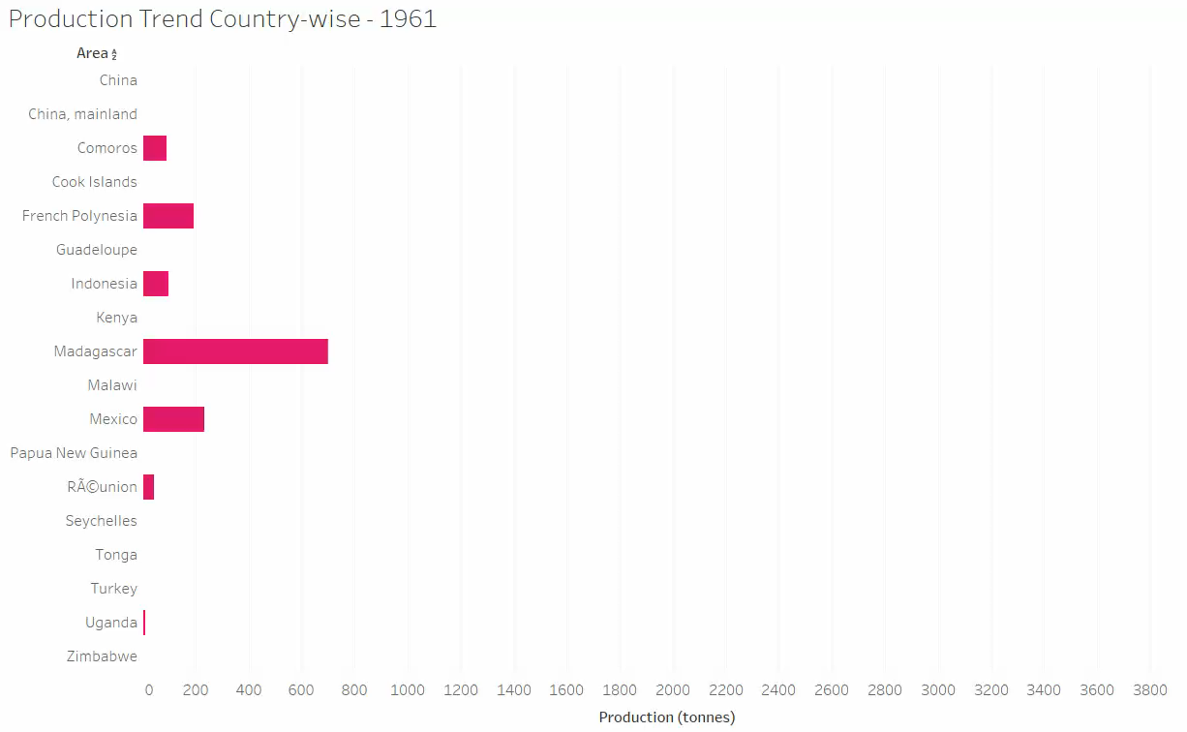
Global Production Trend
The production of vanilla across countries is plotted in the below video. (Press play button)
Notes:
Madagascar was the leading producer of vanilla till 1985, when Indonesia took over. However Madagascar is back in the leading position in the last few years

Slide 10
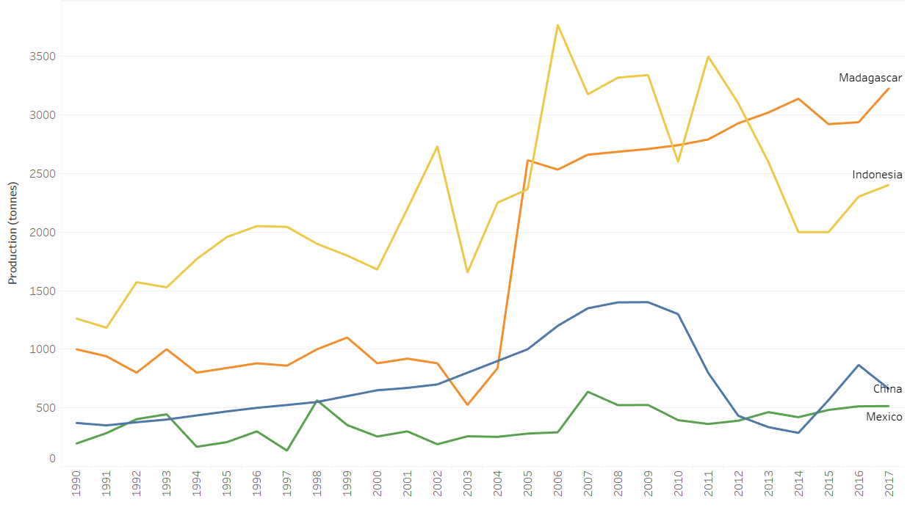
Global Production Trend
The production of vanilla across countries is plotted in the below video. (Press play button)
Notes:
Madagascar was the leading producer of vanilla till 1985, when Indonesia took over. However Madagascar is back in the leading position in the last few years

Slide 11
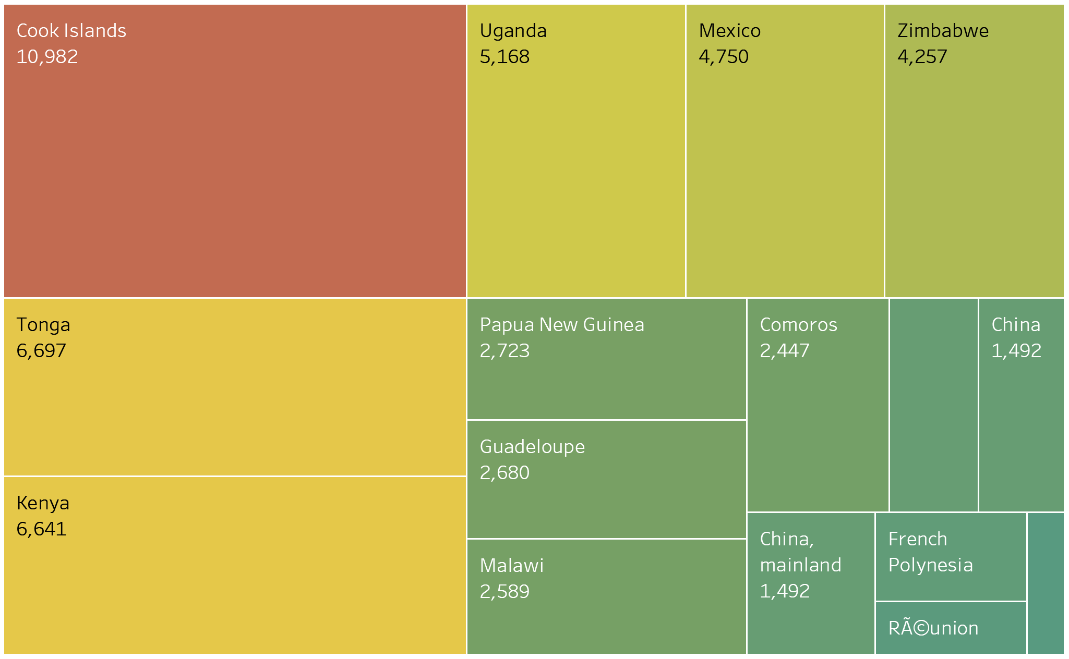
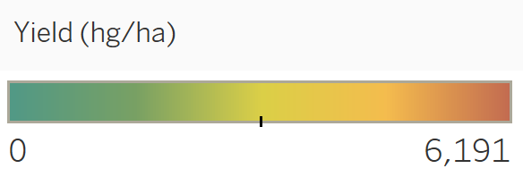
Countries and their yield
Countries and their yields represented in hg/ha

Slide 12
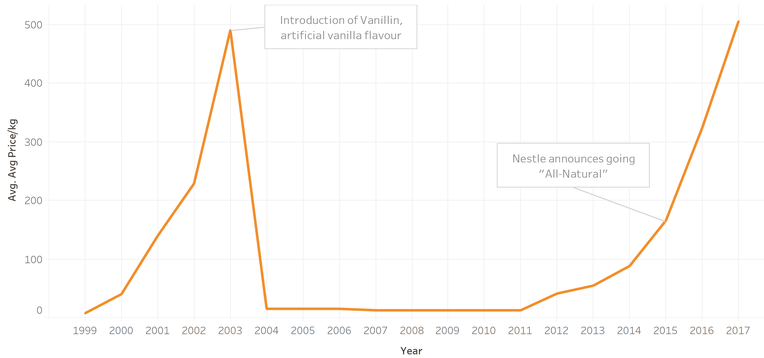
Price trend analysis
Vanillin, the primary component of natural vanilla bean was synthetically manufactured and was introduced as a substitute of natural vanilla in 2003, dropping the prices.
In 2015, Nestle announced going All-Natural, followed by Hershey’s and various food manufacturers, increasing the prices again.
About 5-7 pounds of green vanilla beans are needed to produce one pound of processed vanilla
Notes:
Synthetic vanillin - twenty-fold cheaper than real vanilla, sold 20,000 metric tons per year.

Slide 13
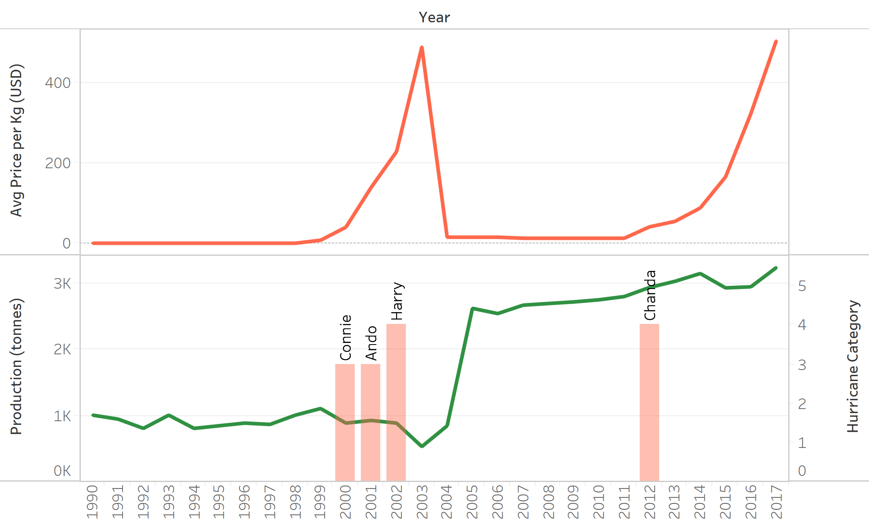
Effect of climate on price
The production of vanilla in Madagascar
Madagascar is the leading manufacturer of vanilla and is frequently affected by tropical storms and/or hurricanes.
The hurricanes Harry in year 2002 decreased the total production in Madagascar and increased the average global price.
Notes:
Vanilla represents 20% of Madagascan exports, worth around $600m at current prices
In 2015 Madagascar experienced poor flowering and a very small vanilla bean crop. Buyers quickly purchased the last of 2014 crop, knowing prices would go up. Hoarding increased prices further up
By holding the beans off the market, the speculators forced the prices up further.
The crop report was released before March 2017, when Madagascar — where 80 percent of the world's vanilla is produced — had 30 percent of its vanilla crop damaged by Tropical Storm Enawo
https://vanillaqueen.com/will-2016-vanilla-crop-see-easing-prices/

Slide 14
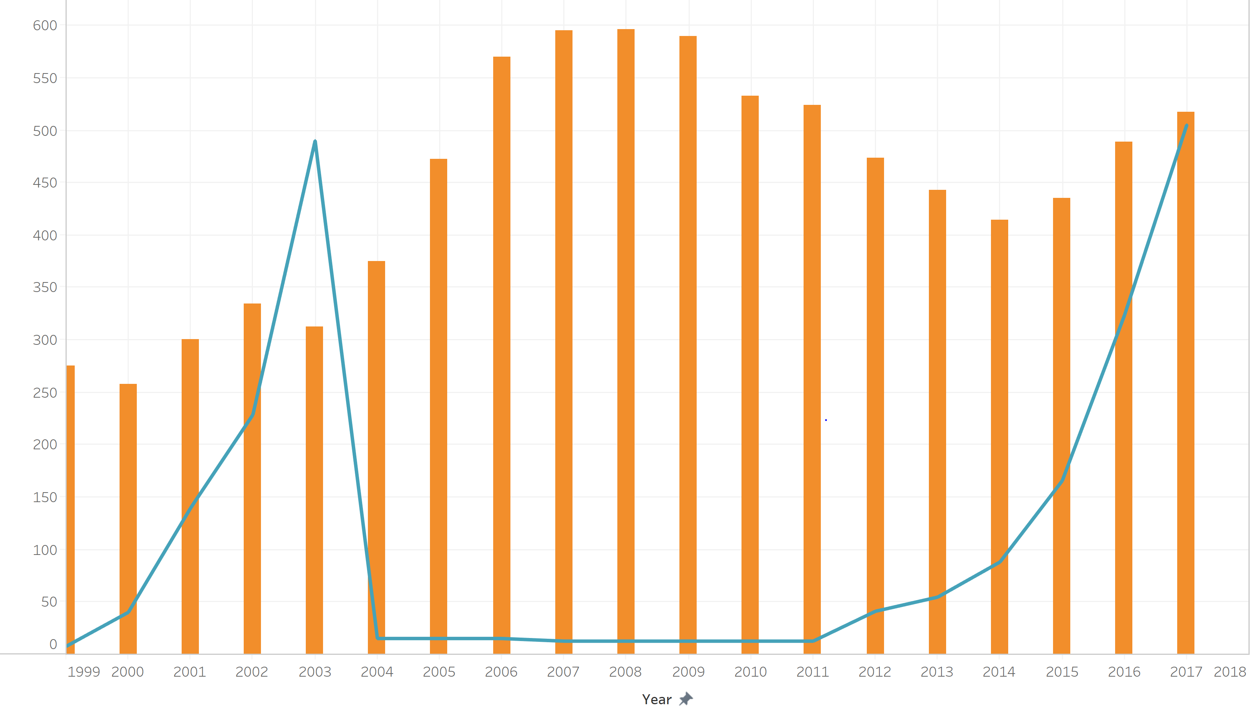
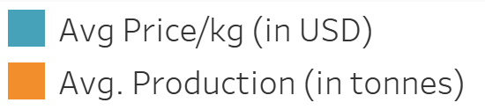
Price and Production
Following the price trend in early 2000’s more farmers would have started cultivation of vanilla
The low price of vanilla between the years 2004-2008 can be accounted for the consistent decline in production from 2008 till 2014

Slide 15
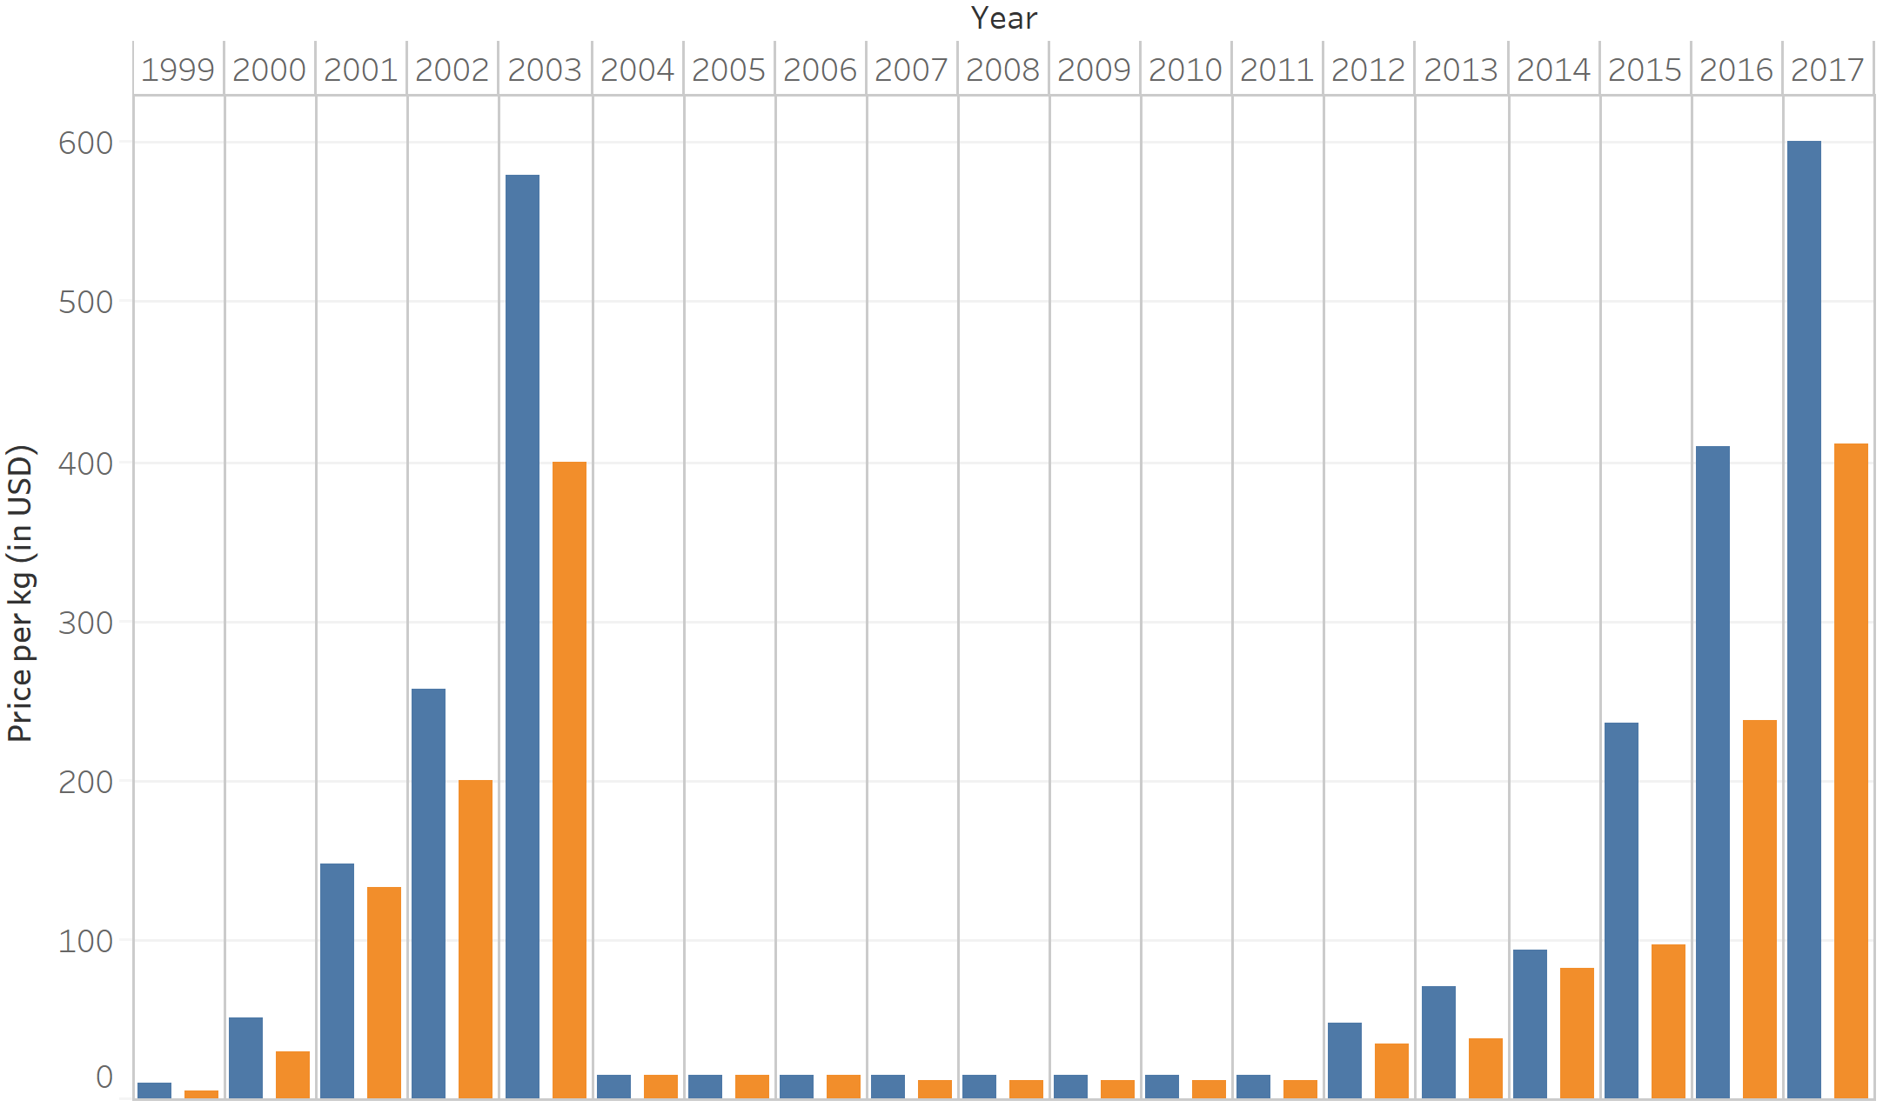

Minimum and maximum price
Wide variation between maximum and minimum prices
Stealing of unripe bean from plants and introducing low quality beans to market decreased the vanilla prices.
When the farmers introduce good quality processed beans, the price increases for the same year.
Notes:
Vanilla is an expensive spice and hence the prices are generally high.
Reason for min price.
Vanilla cultivators wait for the beans to ripen in order to harvest them. Meanwhile people steal the raw beans which would still fetch them a good price. To prevent further stealing, farmers are forced to sell unripe beans. The unripe beans thus sold in the market leads to lower quality products in the market and a consequent decrease in price.
To help the farmers:
The government has enforced laws against the sale of green beans
The farmers started stamping the beans with their ids to prevent the sale by 3rd person.

Slide 16
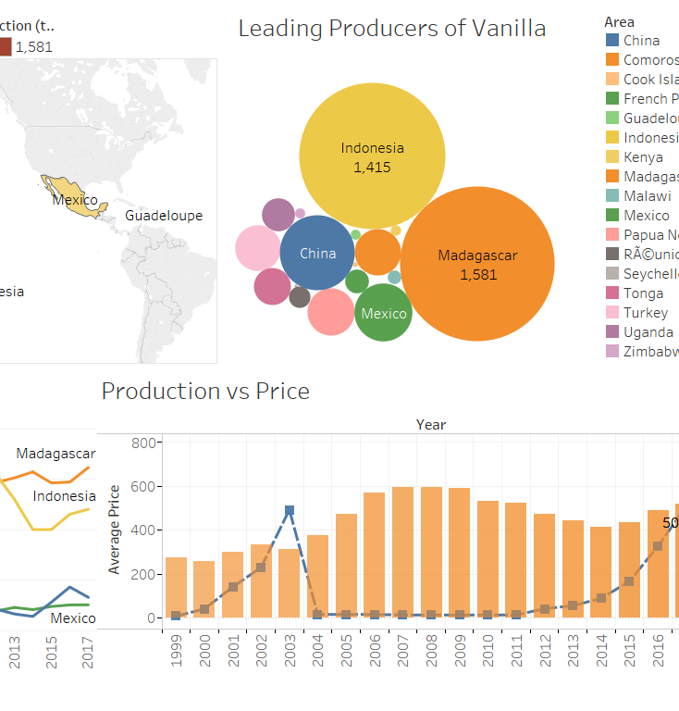
Summary
Analyzed the global vanilla production and its trend over the years
Analyzed the impact of regional, socio-economic, climatic and scientific reasons for the fluctuation in price.

Slide 17


The Team
Gayathri
Muraleedharan
Neethu
Narayanan
MS BA
Fall 2018
MS ITM
Fall 2018

Slide 18
References
https://www.wideopeneats.com/vanilla-prices-on-the-rise/
https://agronomag.com/vanilla-price-hits-all-time-record-in-2018/
https://www.bbc.com/news/business-44006176
https://www.nhc.noaa.gov/climo/
https://globalriskinsights.com/2013/08/the-world-vanilla-market-is-anything-but-vanilla/
http://www.fao.org/fileadmin/user_upload/inpho/docs/Post_Harvest_Compendium_-_Vanilla.pdf
https://www.nationalgeographic.com/people-and-culture/food/the-plate/2014/10/23/plain-vanilla/

Slide 19
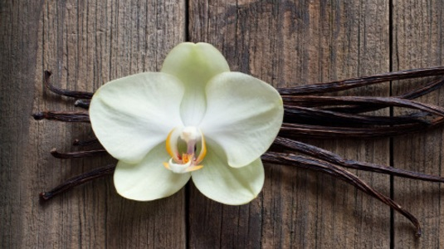
Thank You

